Slide 1


Employee recommendation system
BE PROJECT

Slide 2



Group Members
GUIDE: Prof. Jyotsna More
Sayali Pawar (XIEIT161735)
Namrata Bomble(XIEIT171866)
Bhavin Nirmal(XIEIT171870)

Slide 3


EMPLOYEE RECOMMENDATION System
Problem Definition
The main objective of a company or organization is to reduce the manpower by automating the processes they are performing manually.
We provide a solution to one of the departments of the company, i.e. Human Resources Department.
In most of the companies, the employees are selected based on resumes which are manually analyzed and compared with other resumes which increases the use of human energy and utilizes a lot of time.
To provide solution to this problem, we are developing a working prototype of Employee Recommendation Using Machine Learning.

Slide 4
Scope
The Employee Recommendation/Prediction System can be used by any organization or company to reduce the human effort.
Prediction of employees based on their Skill Set and Work Experience.
The Employee Recommendation System will provide options to the Company to select the algorithms.
The system will be notifying the employees about the results of the selection process.
The system will have the capability to analyze thousands of resumes of employees who will apply for a designation in a company.

Slide 5
EMPLOYEE RECOMMENDATION System
Scope
The Employee Recommendation/Prediction System can be used by any organization or company to reduce the human effort.
Prediction of employees based on their Skill Set and Work Experience.
The Employee Recommendation System will provide options to the Company to select the algorithms.
The system will be notifying the employees about the results of the selection process.
The system will have the capability to analyze thousands of resumes of employees who will apply for a designation in a company.

Slide 6
EMPLOYEE RECOMMENDATION System
Work Flow
Candidates are required to upload their resumes on the website .
The Employee Recommendation System is trained with the dataset to predict the suitable employees.
Three algorithms (Logistic Regression, KNN, Naïve bays) are used to train the model. Model with the highest accuracy (KNN) is selected
The Employee Recommendation System will analyze the resumes and extract data from the resumes such as CGPA ,internships, projects, experience , etc.
The System will generate a list of employees after successful result of machine learning algorithm.
Notify the selected candidates through ‘ERS’ by automating the process of sending emails manually.

Slide 7
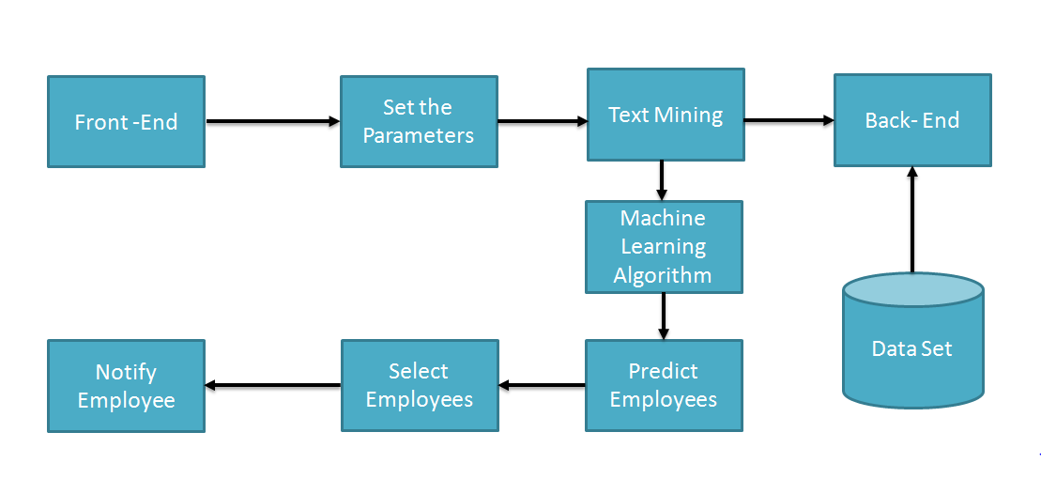
System Architecture

Slide 8
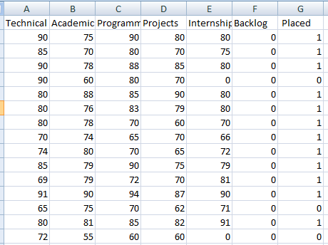
Dataset

Slide 9
Software/Hardware Requirements
HTML,CSS and Nodejs to create user interface where users can upload their resumes .
pyPdf2, for reading PDF files into python.
Python csv library for converting text files into csv format.
Nltk a python library can be used for text mining/information extraction from the resumes(csv form), such as to find out the skill set and education details for the candidate
KNN, Logistic Regression, Naive Bays algorithm for recommendation
Email Notification

Slide 10
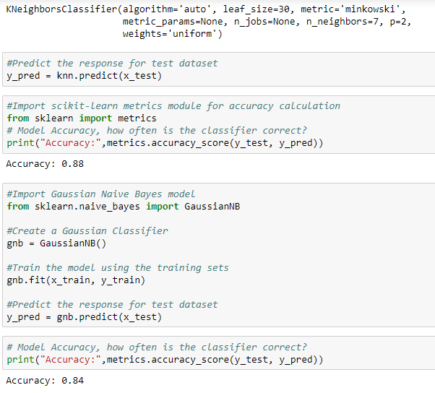
Results

Slide 11
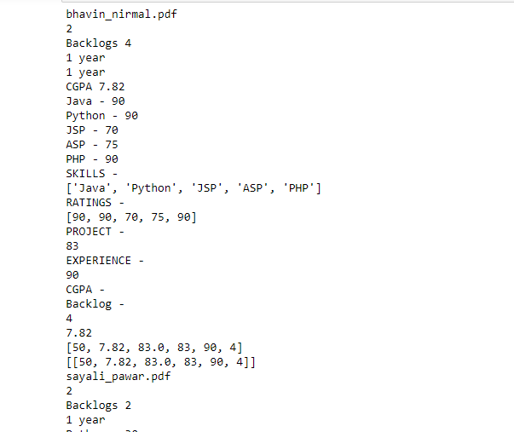
Results

Slide 12
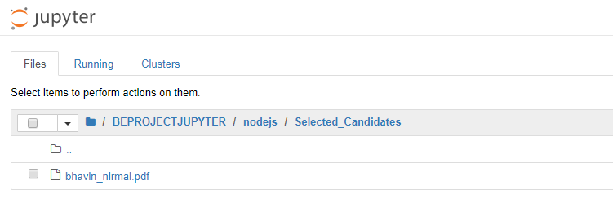
Results
Selected Candidates

Slide 13

Conclusion
Employee Recommendation System will solve the hiring problem of many organizations by recommending the most suitable employee by analyzing resumes.
System will collect the resumes , will preprocess it to convert it into the form suitable for text mining
System will extract the information from document such as skill set, education.
Based on the parameters set by the organization system will recommend employee by using machine learning algorithm.

Slide 14
References
1] https://www.researchgate.net/publication/314132367
2] https://www.researchgate.net/publication/282836265
3] https://www.researchgate.net/publication/313851778
4]https://www.proschoolonline.com/blog/predictive-analytics-meaning-important-algorithms-learn

Slide 15
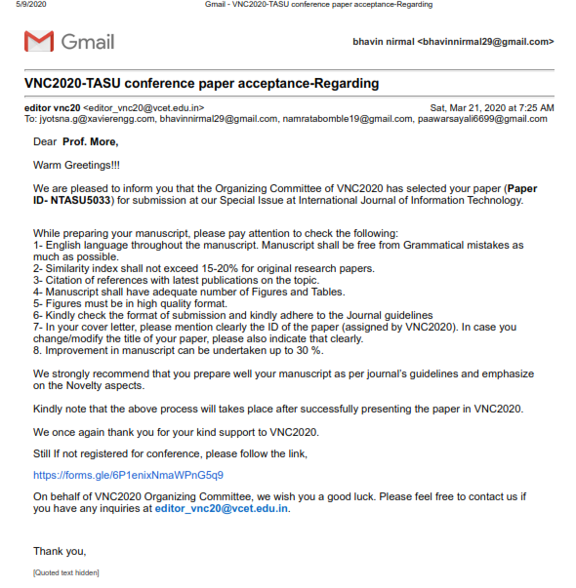
Technical Paper

Slide 16


